Slide 1
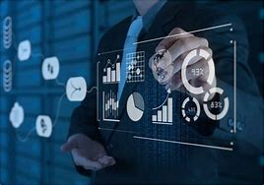
Business Analytics

Slide 2
Agenda
Introduction
Roles
Flow of Analytics Project
Performance Tunning
Factors to consider at different stages
Real world Use cases

Slide 3
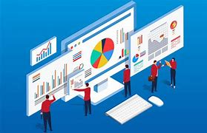
Introduction
What is Business Analytics ?
Why Business Analytics?

Slide 4

What is Business Analytics?
Business analytics is the process of using quantitative methods to derive meaning from data to make informed business decisions.

Slide 5
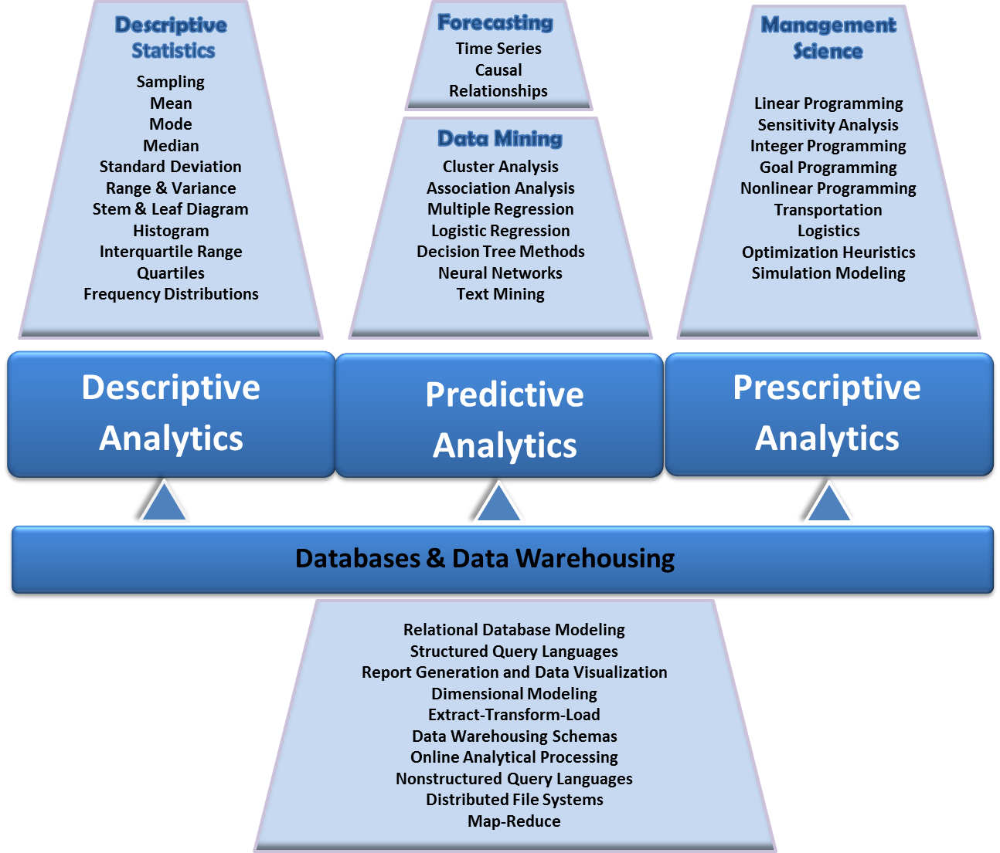
Business Analytics Domain?

Slide 6
Business Analytics
Taking in and processing historical business data
Analyzing that data to identify trends, patterns, and root causes
using quantitative and statistical analysis to design business models
forecasting future business needs, performance, and industry trends with predictive modeling
Making data-driven business decisions based on those insights
communicating findings in easy-to-digest reports to colleagues, management, and customers

Slide 7
Benefits
Data-driven decisions
Easy visualization
Modelling the what-if scenario
Go augmented

Slide 8
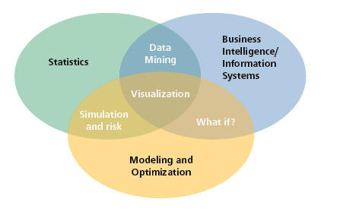
Visual Perspective

Slide 9
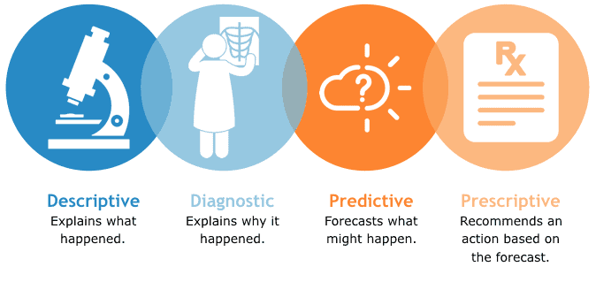
Primary methods of BA

Slide 10
Example
Most department stores clear seasonal inventory by reducing prices.
Key question: When to reduce the price and by how much to maximize revenue?
Potential applications of analytics:
Descriptive analytics: examine historical data for similar products (prices, units sold, advertising, …)
Predictive analytics: predict sales based on price
Prescriptive analytics: find the best sets of pricing and advertising to maximize sales revenue

Slide 11
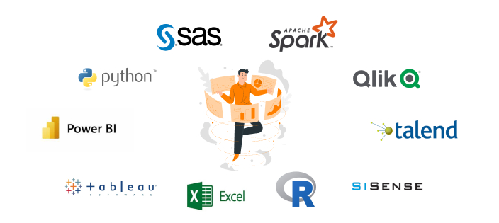
Tools for BA

Slide 12
Business analytics use case : Marketing
Analytics to identify success and impact Which customers are more likely to respond to an email campaign? What was the last campaign’s ROI?
More and more marketing departments are trying to better understand how their programs affect the business at large.
With AI and machine learning powering analysis, it’s possible to use data to drive strategic marketing decisions

Slide 13
Business analytics : HR
Analytics to find and share talent insights What actually drives employee decisions regarding their career?
HR leaders are trying to better understand how their programs affect the business at large.
With the right analytical capabilities, HR leaders can quantify and predict outcomes, understand recruitment channels, and review employee decisions
Insights into Recruitment, Attrition and Payroll

Slide 14
Business analytics : Finance
Analytics to power predictive organizational budgets How can you increase your profit margins?
Finance works with every department, be it HR or sales.
That means that innovation is always key, especially as finance departments face larger volumes of data.
With analytics, it’s possible to bring finance into the future for predictive modeling, detailed analysis, and insights from machine learning

Slide 15
Business analytics use case : Sales
Analytics to optimize your sales What is the critical moment that converts a lead to a sale?
In-depth analytics can break down the sales cycle, taking in all of the different variables that lead to a purchase.
Price, availability, geography, season, and other factors can be the turning point on the customer journey—and analytics offer the tool to decipher that key moment

Slide 16
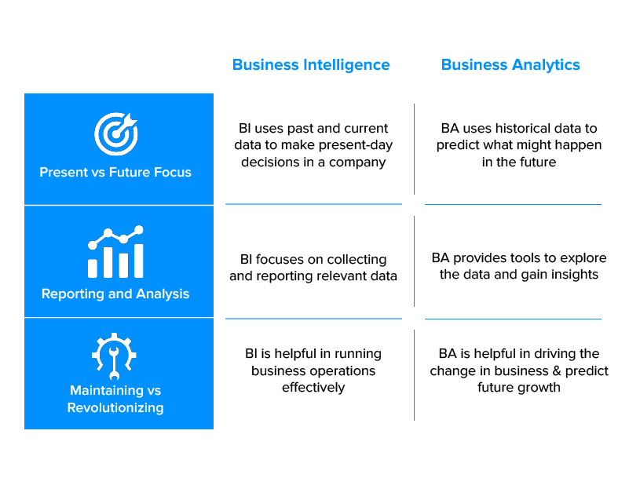
Business Intelligence Vs Business Analytics

Slide 17
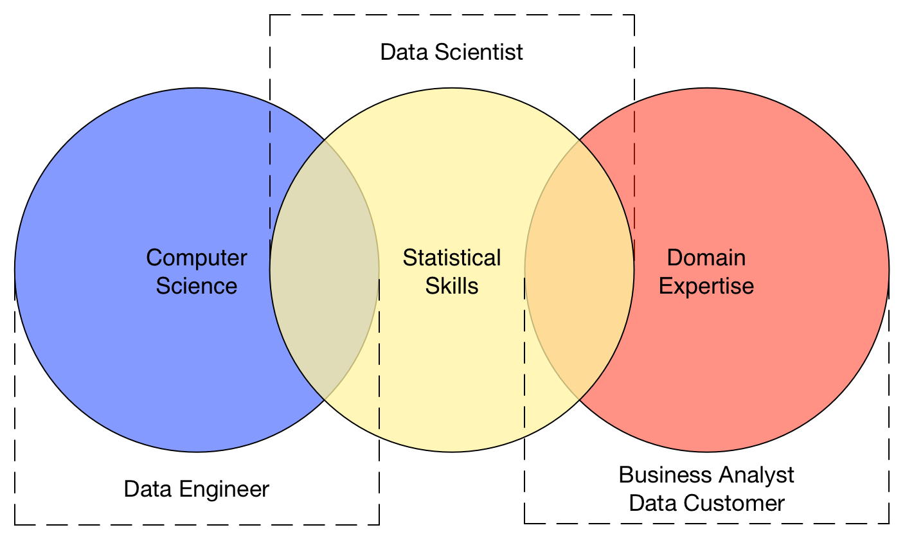
Roles

Slide 18
Business Analyst
A Business Analyst is a person who helps businesses to analyze their processes, products, services, and systems to improve current processes and make profitable decisions through insights and data analysis.
A Business analyst also helps organizations to document business processes by assessing the business model and its integration with technology.

Slide 19
Responsibilities of Business Analyst
Evaluating a company’s current functions and IT structures
Understand the Requirement of the Businesses
Reviewing processes and interviewing team members to identify areas for improvement
Presenting findings and recommendations to management and other key stakeholders
Support the Project Implementation
Functional Requirements and Non-Functional Requirements
User Acceptance Testing
Technical Writing, Decision Making & Problem Solving

Slide 20
Data Analyst
A data analyst gathers, cleans, and studies data sets to help solve problems
Data Analysis Process :
Identify the data you want to analyze
Collect the data
Clean the data in preparation for analysis
Analyze the data
Interpret the results of the analysis

Slide 21
Comparison
Data analyst | Business analyst
Data analysis | Needs analysis
Statistics | Prototyping
Knowledge of data structures | Knowledge of business structures
SQL and statistical programming | Microsoft Visio and software design tools

Slide 22
What is a business intelligence (BI) analyst?
BI analysts are somewhat of a hybrid between business and data analysts.
They use analysis, modeling, and visualization of industry trends and the competitive landscape to help businesses cut losses and increase profits.

Slide 23
Data Engineer
Data engineering is the practice of designing and building systems for collecting, storing, and analyzing data at scale
These are some common tasks you might perform when working with data:
Acquire datasets that align with business needs
Develop algorithms to transform data into useful, actionable information
Build, test, and maintain database pipeline architectures
Collaborate with management to understand company objectives
Create new data validation methods and data analysis tools
Ensure compliance with data governance and security policies

Slide 24
ML Engineer
Implementing machine learning algorithms
Running AI systems experiments and tests
Designing and developing machine learning systems
Performing statistical analyses

Slide 25
Data Analyst and Data Scientist
 | Data analyst | Data Scientist
Mathematics | Foundational math, statistics | Advanced statistics, predictive analytics
Programming | Basic fluency in R, Python, SQL | Advanced object-oriented programming
Software and tools | SAS, Excel, business intelligence software | Hadoop, MySQL, TensorFlow, Spark
Other skills | Analytical thinking, data visualization | Machine learning, data modeling

Slide 26
Models in Business Analytics
Model - an abstraction or representation of a real system, idea, or object.
Often a simplification of the real thing.
Captures the most important features.
Can be a written or verbal description, a visual representation, a mathematical formula, or a spreadsheet

Slide 27
Three forms of a model
The sales of a new product, such as a first-generation iPad or 3D television, often follow a common pattern.
Verbal description
The rate of sales starts small as early adopters begin to evaluate a new product and then begins to grow at an increasing rate over time as positive customer feedback spreads. Eventually, the market begins to become saturated, and the rate of sales begins to decrease

Slide 28
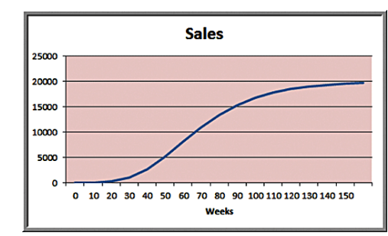
Forms of model
2.Visual model: A sketch of sales as an S-shaped curve over time

Slide 29
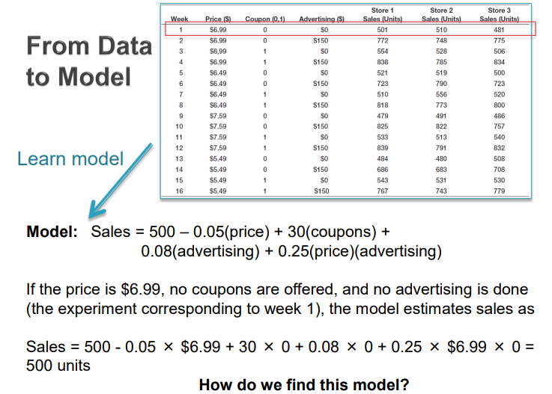
From data to model

Slide 30

Forms of model
3. Mathematical Model
Where
S is sales,
t is time,
e is the base of natural logarithms, and
a, b and c are constants that need to be estimated.

Slide 31
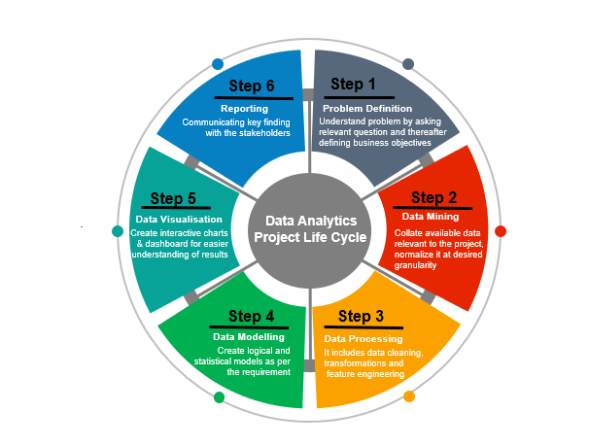
Stages in Analytics Project

Slide 32
Performance Tunning
Volume of Data
Computation Cost in Cloud
Client Budget
How to pick the tools in every stage

Slide 33
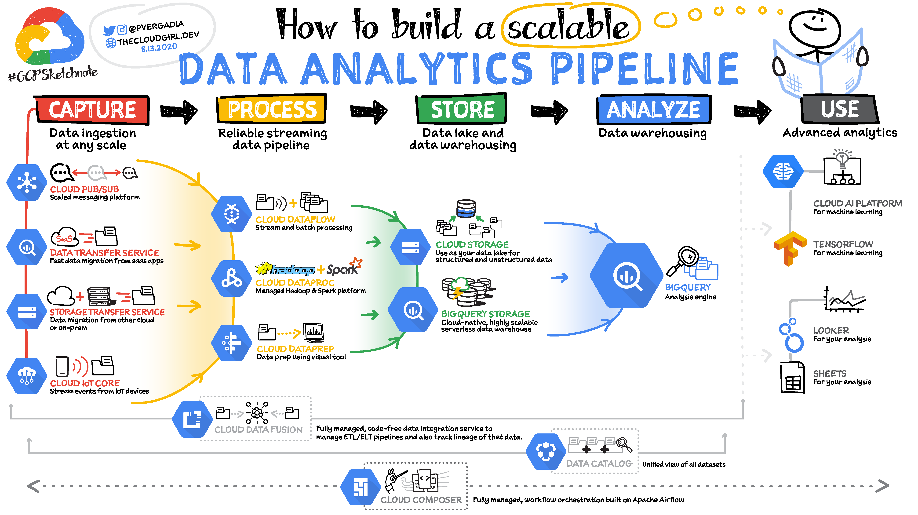

Slide 34
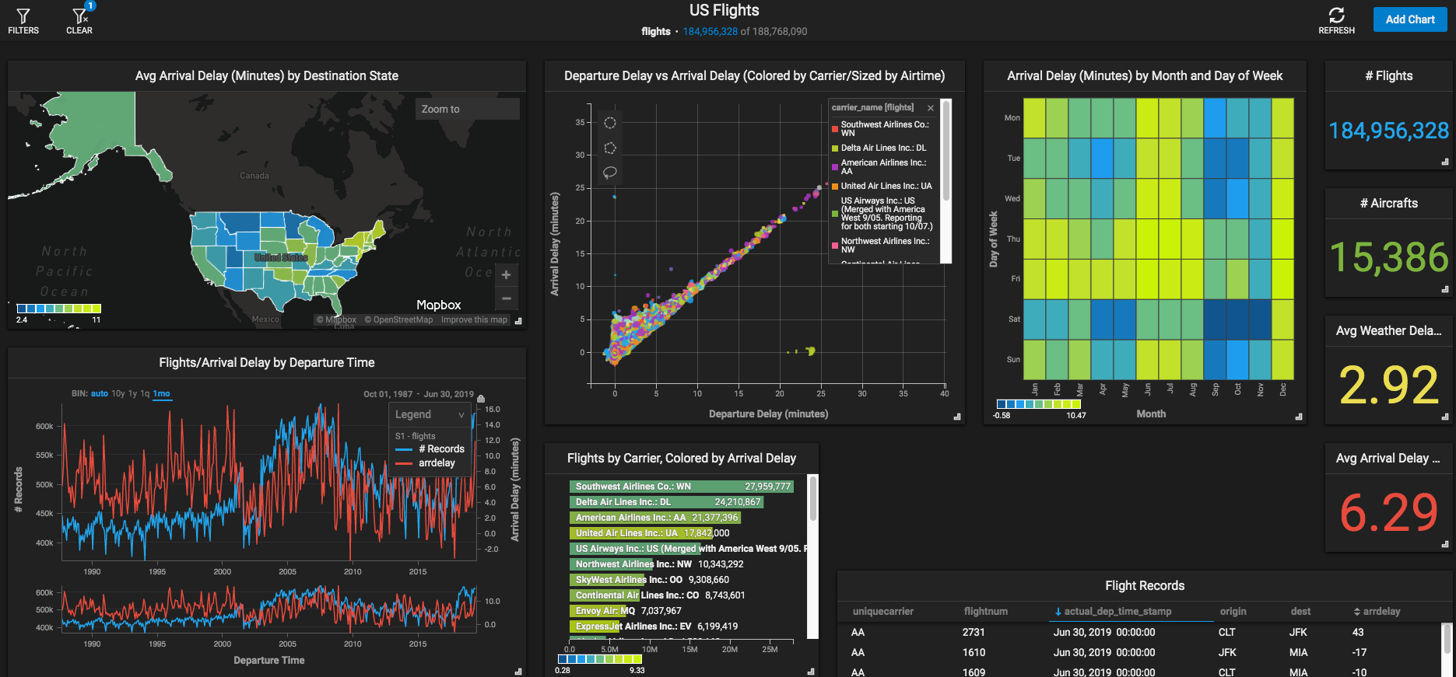
Activity 1 -Data in the Airline Industry
Go to Website
Open Link
Explore the interactive Big Data Visualization of US Airline Flights

Slide 35
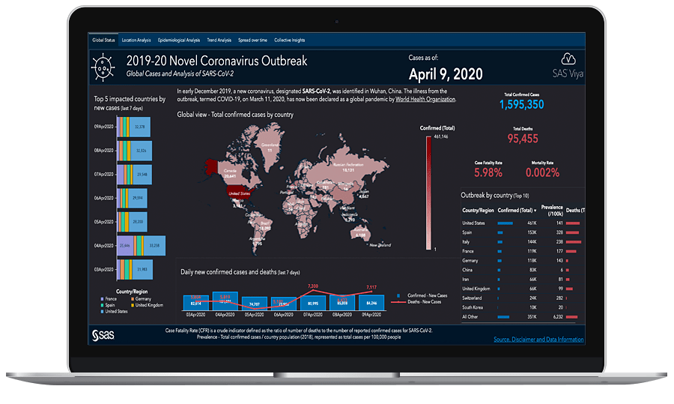
Activity 2 – Corona Virus Tracking
Go to Website
https://tbub.sas.com/COVID19/
Stay current on critical statistics – including the daily number of confirmed cases, recovery rates, patient deaths and more – related to the 2019 novel coronavirus (COVID-19) outbreak

Slide 36
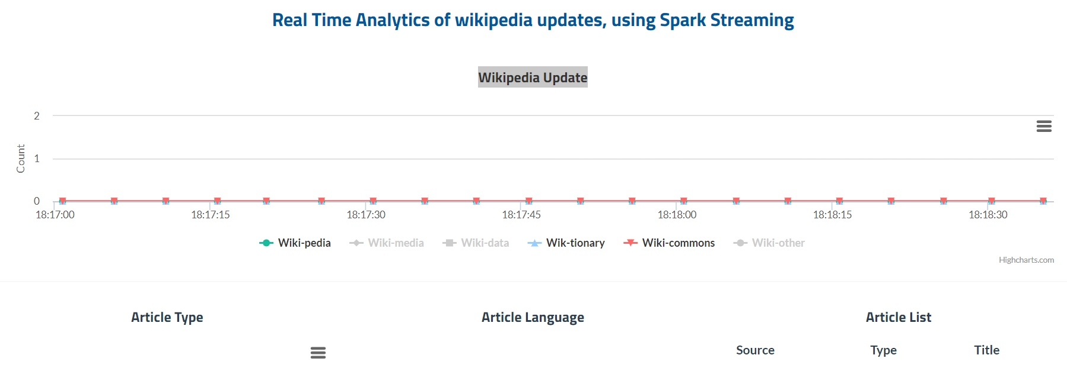
Activity 3 – Real time analytics of Wikipedia updates
Go to Website
Click Here
See the use of Apache Spark in real time analytics of Wikipedia updates

Slide 37
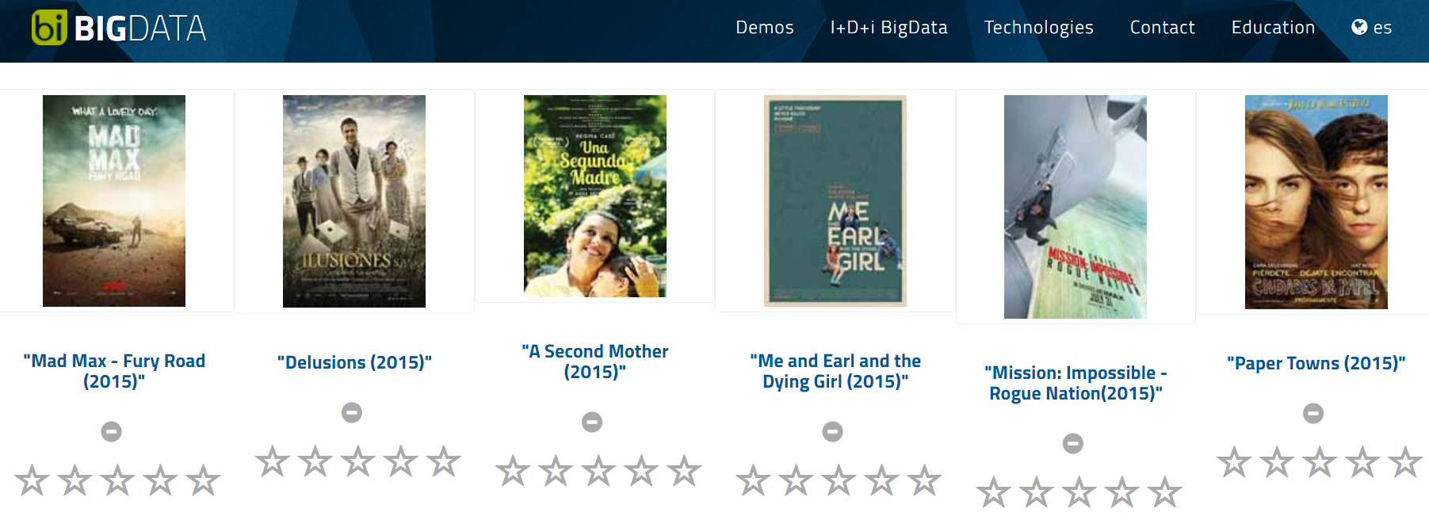
Activity 4 – Predictive analytics
In this Activity we will see the movie recommender system with machine learning
Go to Website
Click Here
use of Apache Spark MLib

Slide 38
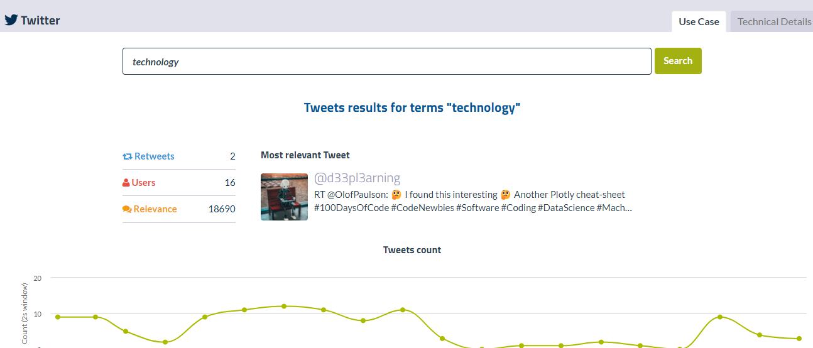
Activity 5 – Twitter -Data analytics
In this Activity you need to type a name of tweet and then system will find the relevant tweets using Apache kafka cluster
Go to Website
Click Here
use of Apache Kafka

